Slide 1
CMOS
Power

Slide 2
Outline
Power and Energy
Dynamic Power
Static Power

Slide 3
Power and Energy
Power is drawn from a voltage source attached to the V_{DD} pin(s) of a chip.
Instantaneous Power:
P(t) = I (t)V (t)
T
E = ∫ P(t)dt
0
Energy:
₁ T
E
Average Power:
P_{avg} = _{T} = _{T ∫} P(t)dt
0

Slide 4



Power in Circuit Elements
^{P}VDD (^{t} ) ^{= I}DD (^{t} )^{V}DD
V
2
( )
P (t ) =
t
R
2
( )
= I t R
R
R
R
∞ ∞
dV
E_{C} = ∫ I (t )V (t ) dt = ∫C _{dt} V (t ) dt
0 0
V_{C}
= C V t dV =
0
∫
( )
1 2
CV
2
C

Slide 5
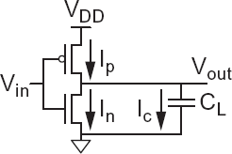
Charging a Capacitor
When the gate output rises
– Energy stored in capacitor is
E = ¹ C V ²
C 2 L DD
– But energy drawn from the supply is
∞ ∞
dV
E_{VDD} = ∫ I (t )V_{DD} dt = ∫C_{L dt} V_{DD}dt
0 0
^{V}DD
= C V
L DD ∫
dV = C V ²
L DD
0
– Half the energy from V_{DD} is dissipated in the pMOS
transistor as heat, other half stored in capacitor
When the gate output falls
Energy in capacitor is dumped to GND
Dissipated as heat in the nMOS transistor

Slide 6
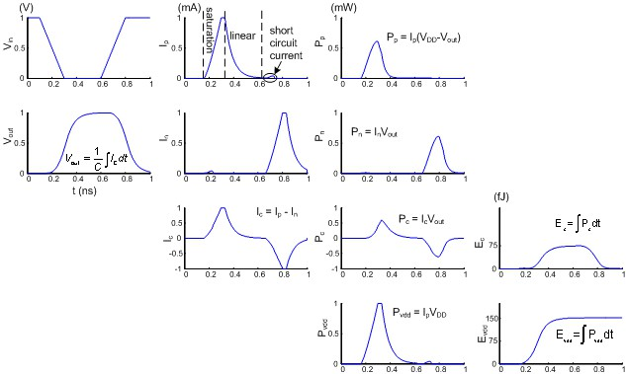
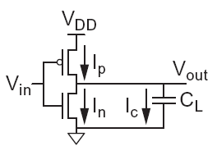
Switching Waveforms
Example: V_{DD} = 1.0 V, C_{L} = 150 fF, f = 1 GHz

Slide 7
Switching Power
₁ T
^{P}switching ⁼ _{T} ∫ ^{i}DD ^{(t)V}DD ^{dt}
0
V
T
= ^{DD} ∫ i_{DD} (t)dt
T
0
= ^{VDD} [Tf CV
]
T
= CV
sw
DD
VDD
2 _{f}
i (t)
^{f}sw
DD
DD sw
C

Slide 8
Activity Factor
Suppose the system clock frequency = f
Let f_{sw} = αf, where α = activity factor
If the signal is a clock, α = 1
If the signal switches once per cycle, α = ½
Dynamic power:
= αCV
2 _{f}
P
switching
DD

Slide 9
Short Circuit Current
When transistors switch, both nMOS and pMOS networks may be momentarily ON at once
Leads to a blip of “short circuit” current.
< 10% of dynamic power if rise/fall times are comparable for input and output
We will generally ignore this component

Slide 10
Power Dissipation Sources
^{P}total ^{= P}dynamic ^{+ P}static
^{Dynamic power: P}dynamic ^{= P}switching ^{+ P}shortcircuit
Switching load capacitances
Short-circuit current
^{Static power: P}static ^{= (I}sub ^{+ I}gate ^{+ I}junct ^{+ I}contention^{)V}DD
Subthreshold leakage
Gate leakage
Junction leakage
Contention current

Slide 11
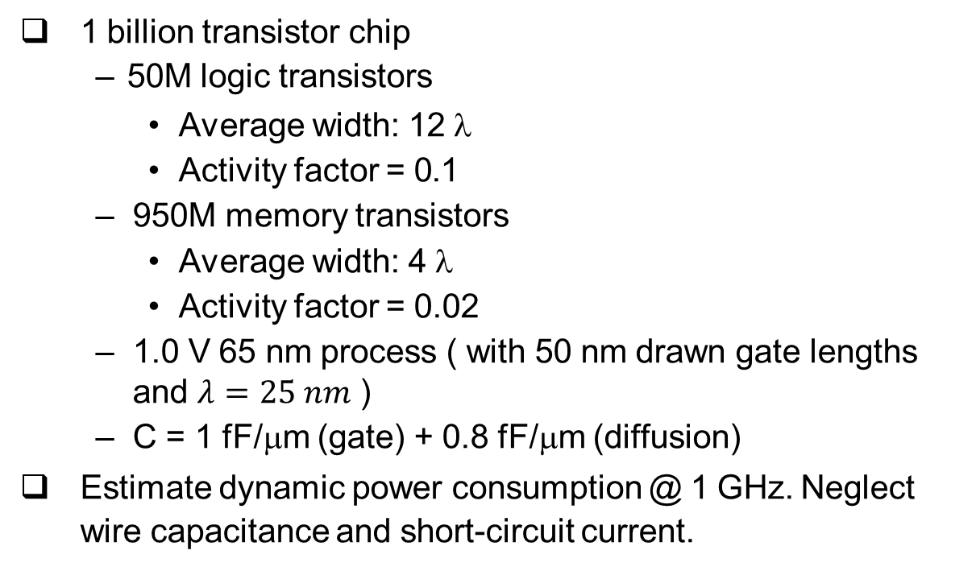
Dynamic Power Example
1 billion transistor chip – 50M logic transistors
Average width: 12 λ
Activity factor = 0.1
950M memory transistors
Average width: 4 λ
Activity factor = 0.02
1.0 V 65 nm process ( with 50 nm drawn gate lengths and $λ=25 nm$ )
C = 1 fF/μm (gate) + 0.8 fF/μm (diffusion)
Estimate dynamic power consumption @ 1 GHz. Neglect wire capacitance and short-circuit current.

Slide 12
Solution
C = (50×10⁶ )(12λ )(0.025μm / λ )(1.8 fF / μm) = 27 nF
logic
C_{mem} = (950×10 )(4λ )(0.025μm / λ )(1.8 fF / μm) = 171 nF
6
+ 0.02C
⎤⎦ (1.0)² (1.0 GHz) = 6.1 W
^{P}dynamic ⁼ ⎣^{⎡0.1C}logic
mem

Slide 13
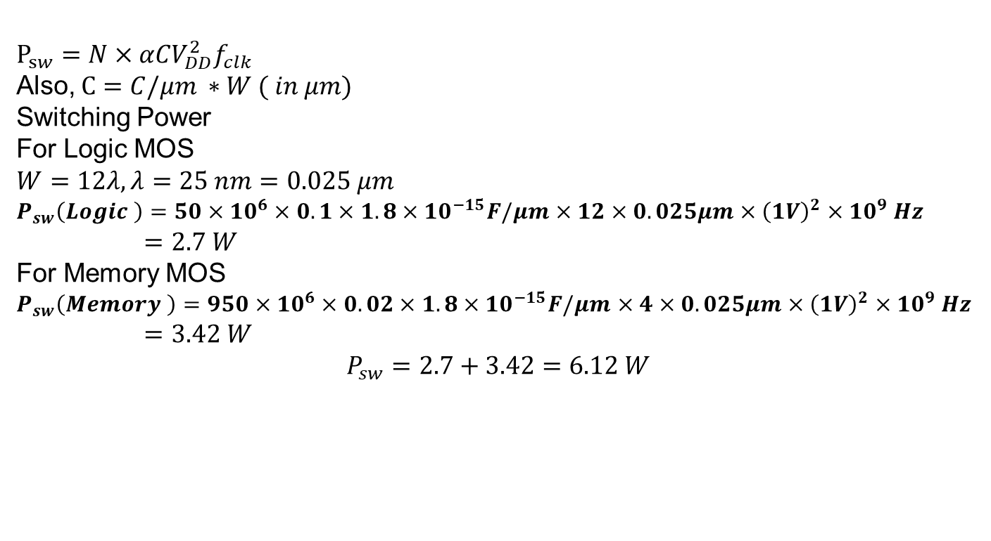
Alternative Solution
$$P_{sw}=N×αCV_{DD}^{2}f_{clk}$$
Also, $C=C/μm ∗W ( in μm)$
Switching Power
For Logic MOS
$$W=12λ, λ=25 nm=0.025 μm$$
$P_{sw}\left(Logic \right)=50×{10}^{6}×0.1×1.8×{10}^{−15}F/μm$ $×12×0.025μm×{\left(1V\right)}^{2}×{10}^{9} Hz$
$=2.7 W$
For Memory MOS
$P_{sw}\left(Memory \right)=950×{10}^{6}×0.02×1.8×{10}^{−15}F/μm$ $×4×0.025μm×{\left(1V\right)}^{2}×{10}^{9} Hz$
$=3.42 W$
$$P_{sw}=2.7+3.42=6.12 W$$

Slide 14
Dynamic Power Reduction
= αCV
2 _{f}
P
switching DD
Try to minimize:
Activity factor
Capacitance
Supply voltage
Frequency

Slide 15
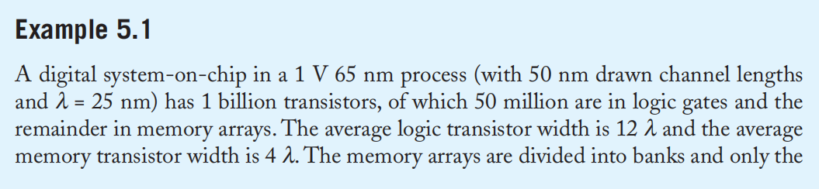
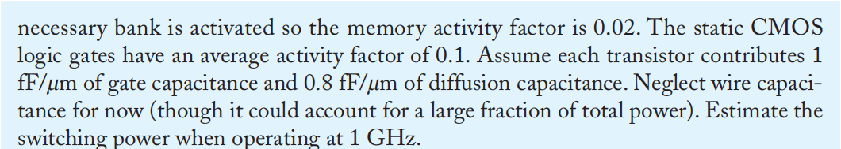
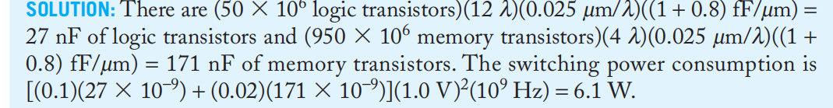
Example:

Slide 16
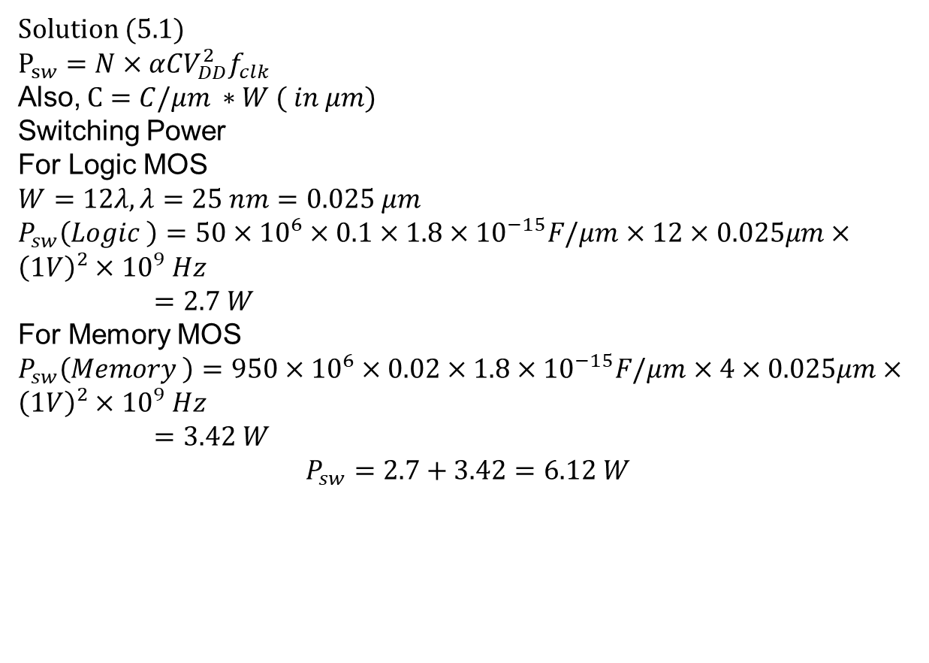
Example:
Solution (5.1)
$$P_{sw}=N×αCV_{DD}^{2}f_{clk}$$
Also, $C=C/μm ∗W ( in μm)$
Switching Power
For Logic MOS
$$W=12λ, λ=25 nm=0.025 μm$$
$P_{sw}\left(Logic \right)=50×{10}^{6}×0.1×1.8×{10}^{−15}F/μm$ $×12×0.025μm×{\left(1V\right)}^{2}×{10}^{9} Hz$
$=2.7 W$
For Memory MOS
$P_{sw}\left(Memory \right)=950×{10}^{6}×0.02×1.8×{10}^{−15}F/μm$ $×4×0.025μm×{\left(1V\right)}^{2}×{10}^{9} Hz$
$=3.42 W$
$$P_{sw}=2.7+3.42=6.12 W$$

Slide 17
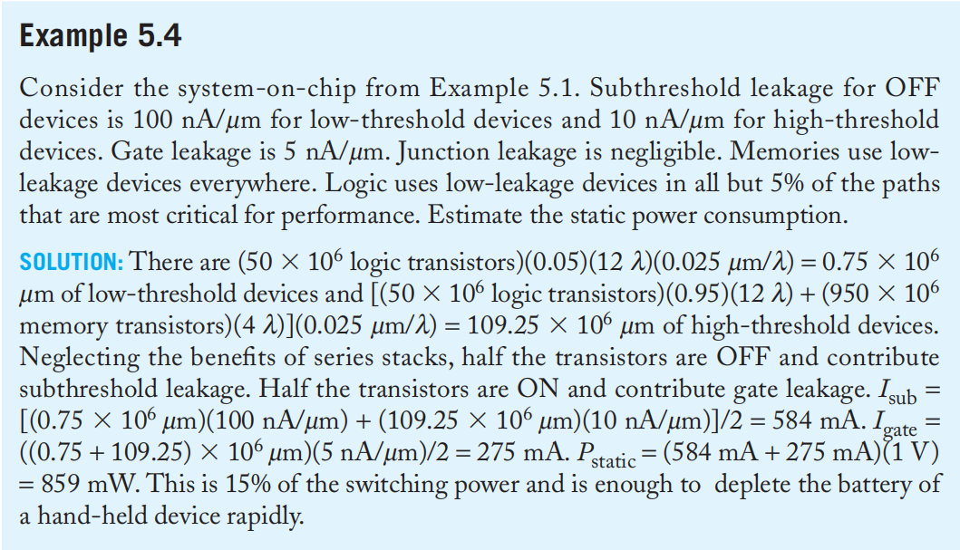
Example:

Slide 18
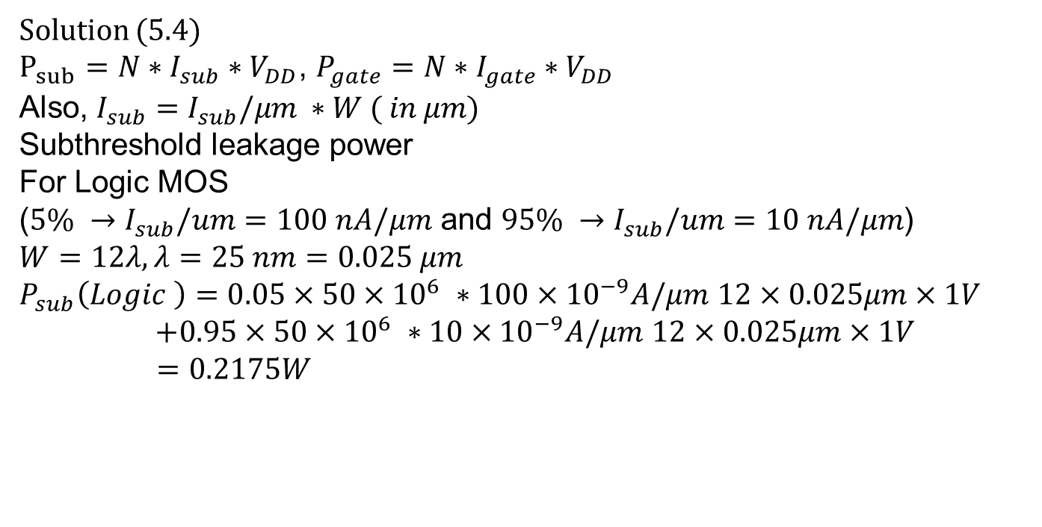
Example:
Solution (5.4)
$P_{sub}=N∗I_{sub}∗V_{DD}$, $P_{gate}={N∗I}_{gate}∗V_{DD}$
Also, $I_{sub}=I_{sub}/μm ∗W ( in μm)$
Subthreshold leakage power
For Logic MOS
($5\% →I_{sub}/um$ $=100 nA/μm$ and $95\% →I_{sub}/um$ $=10 nA/μm$)
$$W=12λ, λ=25 nm=0.025 μm$$
$P_{sub}\left(Logic \right)=0.05×50×{10}^{6} ∗100×{10}^{−9}A/μm$ $12×0.025μm×1V$
$+0.95×50×{10}^{6} ∗10×{10}^{−9}A/μm$ $12×0.025μm×1V$
$=0.2175W$

Slide 19
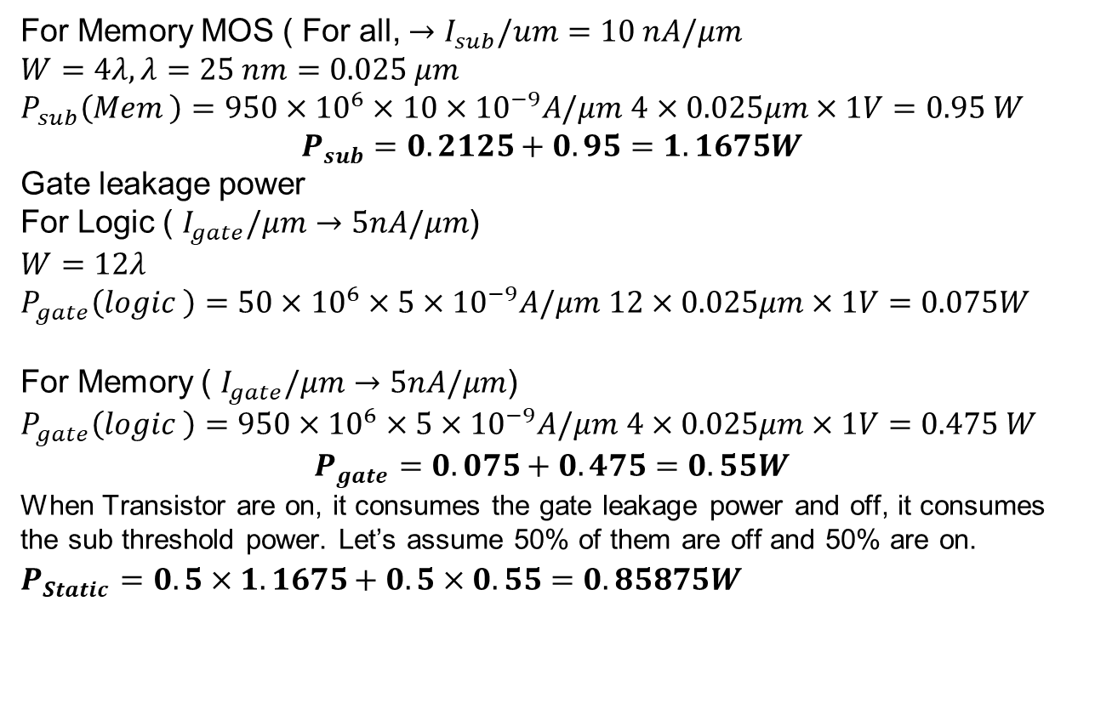
Example:
For Memory MOS ( For all, $→I_{sub}/um$ $=10 nA/μm$
$$W=4λ, λ=25 nm=0.025 μm$$
$P_{sub}\left(Mem \right)=950×{10}^{6}×10×{10}^{−9}A/μm$ $4×0.025μm×1V=0.95 W$
$$P_{sub}=0.2125+0.95=1.1675W$$
Gate leakage power
For Logic ( $I_{gate}/μm$ $→5nA/μm$)
$$W=12λ$$
$P_{gate}\left(logic \right)=50×{10}^{6}×5×{10}^{−9}A/μm$ $12×0.025μm×1V=0.075W$
For Memory ( $I_{gate}/μm$ $→5nA/μm$)
$P_{gate}\left(logic \right)=950×{10}^{6}×5×{10}^{−9}A/μm$ $4×0.025μm×1V=0.475 W$
$$P_{gate}=0.075+0.475=0.55W$$
When Transistor are on, it consumes the gate leakage power and off, it consumes the sub threshold power. Let’s assume 50% of them are off and 50% are on. $P_{Static}=0.5×1.1675+0.5×0.55=0.85875W$

Slide 20
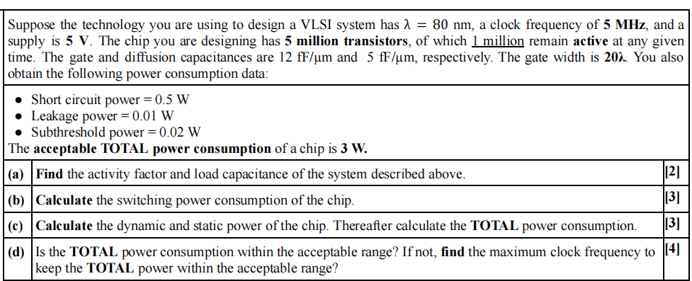
Example:

Slide 21
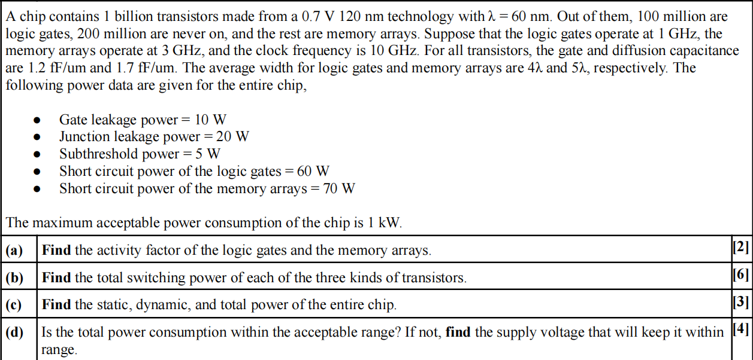
Example:

